Slide 1
Java AWT
Computer Programming
Distributed Computing System Laboratory
Department of Computer Science and Engineering
Seoul National University, Korea
05/30/2017

Slide 2
Overview
AWT Basic
Using AWT
AWT Event Handling
More Details

Slide 3
What is AWT?
Abstract Window Toolkit
Class for graphic features
  Features supported by most GUI platform
  Classic Windows programming method
  System dependent
  heavyweight component
  java.awt.*
Roles
  Control and manage graphic context
  Print out figures and text
  Control and manage image related resources
Notes:
고전적인 윈도우 프로그래밍 방식
GUI 관련 그래픽이 실행되는 시스템에 의존
Heavyweight component
이러한 단점 때문에 Swing이 개발됨
Swing은 경량 컴포넌트임
Java.awt.* 코드 작성시 반드시import해야한다
그래픽 컨텍스트 제어 및 관리
색, 폰트, 좌표, 클리핑, 그리기 모드 등의 정보를 저장하고 제어
도형과 텍스트 출력
문자열과 직선, 사각형등 각종 도형을 그리는 기능
이미지 관련
이미지를 출력하거나 복사 할 수 있는 기능
Swing
운영 환경에 영향을 받지 않고 동일한 화면을 보여줄 수 있도록 시스템에 대한 의존도를 최소화하고 각종 컴포넌트들을 자바에서 직접 그려서 구현을 하였다. 따라서 여러 환경에서 동일한 모습을 보일 수 있도록 구현되었으나 대신 해당 시스템의 고유한 모습을 보여줄 수 없다.
AWT와의 비교[편집]
이 부분의 본문은 AWT입니다.
AWT는 시스템의 그래픽 컴포넌트를 직접 사용하여 해당 시스템의 모습을 그대로 구현한다.
또한 스레드 보안(Thread Safe)이 되어 있어 스윙과 비교하여 컴포넌트의 업데이트에 문제가 발생하지 않는다.
또한 최소 JDK 1.2, 혹은 성능을 위하여 더 최신의 JVM이 필요한 스윙에 비하여 AWT는 자바에서 지원하는 최초의 그래픽 툴킷으로 버전에 상관없이 모든 JVM에서 사용 가능하다.
마이크로소프트가 썬 마이크로시스템즈와의 자바 사용권에 대한 재판에서 패소함에 따라 신규 JVM을 지원하지 않고 있는데 MS의 기존 JVM에서도 AWT는 사용이 가능하다.(2007년 12월 31일로 만료됨) ^{[2]}
그러나 자바 1.2 이후 컴포넌트의 제약에도 불구하고 Java2D, Java3D 등의 풍부한 그래픽 환경을 제공한다.

Slide 4
Why should we know AWT?
Types of user interface
  CUI (Character User Interface)
  GUI (Graphical User Interface)
Most programs we use are based on GUI
  Windows, Media Player, Editplus, etc.
  In java, we can use AWT & Swing

Slide 5
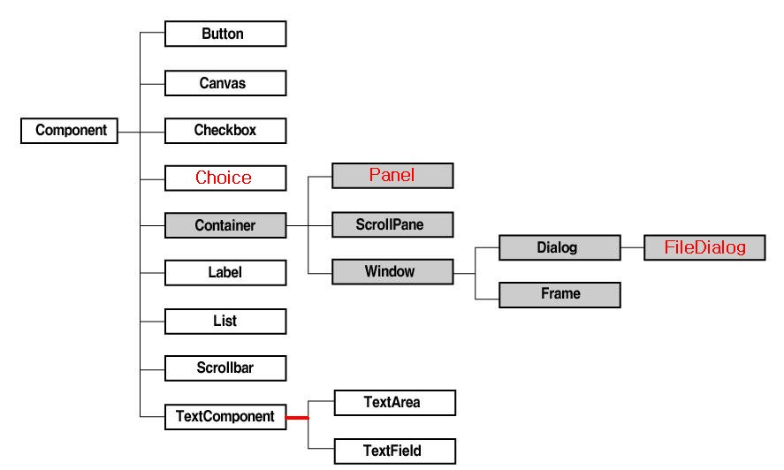
AWT Component
https://docs.oracle.com/javase/7/docs/api/java/awt/package-summary.html

Slide 6
How to use AWT component
1. Create component
  Button myButton= new Button("myButton");
2. Add the component on container
  add(myButton);
3. Create Event handling routine and add EventListener
  MyActionListener mal= new MyActionListener();
  myButton.addActionListener(mal);

Slide 7
Overview
AWT Basic
Using AWT
AWT Event Handling
More Details

Slide 8
Event
Event
  An event user takes act on UI component
Event-based programming
  Program listens event from user and respond for the event while in infinite loop

Slide 9
Handling event
java.awt.event
  Provides various event listener and handler interface and classes for AWT component
    Interface : xxxListener,…
    Class : xxxEvent, xxxAdapter,…
Mandatory event handler model
  Add eventListener class to component(event source)
  Handling specific events

Slide 10
Types of Event
Low-Level Event & Semantic Event
  Handling semantic event is a bit more efficient usually
Semantic Event
  Secondary events from low-level event
    Mouse click
    ㄴ> 2 Low level events :
    Clickstart, Clickend
    Handle with action event
Low-Level Event
  System-level events occurred from user input or component function
Example :
  java.awt.event.ComponentEvent
  java.awt.event.FocusEvent
  java.awt.event.KeyEvent
  java.awt.event.MouseEvent
  java.awt.event.WindowEvent
Example :
  java.awt.event.ActionEvent
  java.awt.event.AdjustmentEvent
  java.awt.event.ItemEvent
  java.awt.event.TextEvent
Notes:
While FocusEvent, KeyEvent, MouseEvent and ComponentEvent can ocurr in any Component; the semantics one, ItemEvent, TextEvent, AdjustmentEvent and ActionEvent are related with a particular type of component. Semantics events somehow have a meaning:

Slide 11
Calling eventListener
processEvent
  Calls eventListener when event happens
  (Listner is often called Handler)
  ex) FocusEvent
  processEvent => processFocusEvent =>
  Create FocusListener instance and handle
processEvent
processFocusEvent
processMouseEvent
FocusListener
processKeyEvent
processComponentEvent
Notes:
생성 후 ID 에 따라 처리함

Slide 12
Event & EventListener
Event classes categorized by components that events can occur in
  Event class has appropriate information and methods
Events are provided for components
  ex:) Events for Button
    ActionEvent, ComponentEvent, FocusEvent, KeyEvent, MouseEvent
  Component that ActionEvent can happen
    Button, List, MenuItem, TextField
  Check API documents for detail

Slide 13
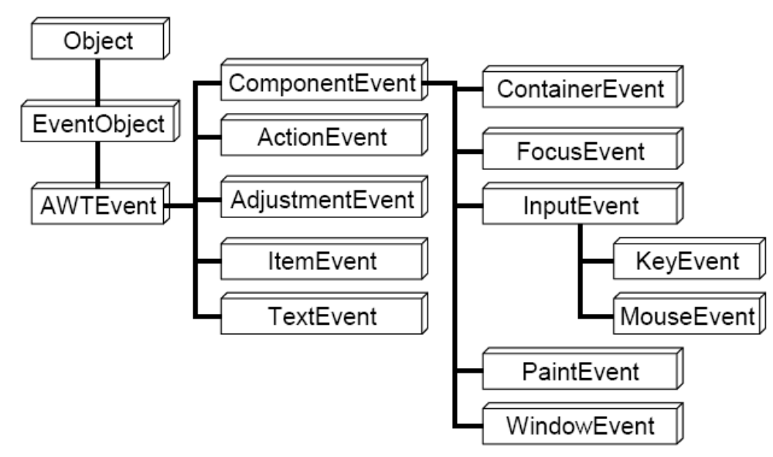
Hierarchy

Slide 14
Event & EventListener
Listerner is interface for event handling
  Event class(xxxEvent) corresponds to Event Listener Interface(xxxListener)
  In eventListener class, methods for handling low-level events exists
  ex:) KeyListener for KeyEvent
    void keyPressed(KeyEvent e)
    void keyReleased(KeyEvent e)
    void keyTyped(KeyEvent e)

Slide 15
Handling event
Select Event to handle
  ex:) ActionEvent
Define class for eventListener
  MyListener for ActionListener
    Class MyListener implements ActionListner{ …}
    Method : void actionPerformed(ActionEvent e) has to be implemented
  Each Listener has its own methods to implement
    See API Documentation
Create instance and add it as eventListener for component
  this.addActionListener(new MyListener());

Slide 16
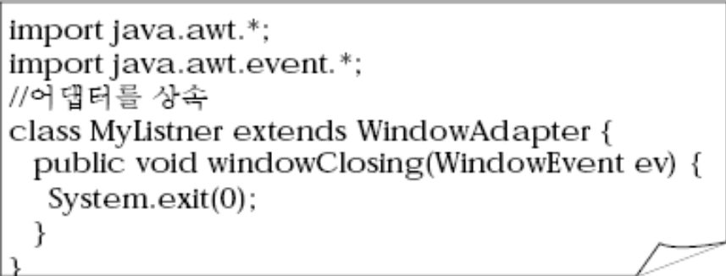
Event Adapter
Easy handling for low-level events
  For Listener interface with more than 2 event handling methods, there exists implemented Adapter class
  Each event handler methods are empty
If Adapter class exists, define class that extends Adapter instead of implementing listener
Overriding
Notes:
It is a pattern which provides default implementation of interface or abstract class.
- Adapter class provides the default implementation of all the methods in an event listener interface.
- Usually adapter classes ease the programmers by providing the implementations of the listener interfaces instead of having to implement them. This is where the event adapter class comes into picture.
- These classes are useful when you want to process only few of the events that are handled by a particular event listener interface.
Advantage
- It increases the transparency of classes.
- It makes a class highly reusable.
- It provides a pluggable kit for developing application.
- It provides a way to include related patterns in a class.
- Using adapters it helps to reduce the clutter in your code.

Slide 17
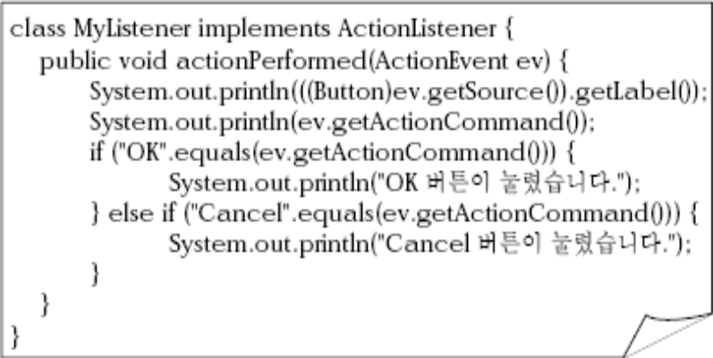
ActionEvent & ActionListener
Major Method of ActionListener
  void actionPerformed(ActionEvent ev)
  When event occurs
    Clicking Button
    Clikcing Menu entry
    Pressing Enter key in TextField
    Double-clicking entry of the list
Major methods for ActionEvent
  String getActionCommand()
    Return the name of command
  Object getSource()
    Method overrided from EventObject

Slide 18
WindowEvent & WindowListener
Major methods for WindowListener
  Case that causes change of condition fo window
  void windowActivated(WindowEvent ev)
  void windowClosed(WindowEvent ev)
Major methods for WindowEvent
  int getNewState()
    0 for normal state
  int getOldState()
  Window getWindow()

Slide 19
ItemEvent & ItemListner
Major methods for ItemListener
  void itemStateChanged(ItemEvent ev)
  Selecting/Deselecting items from Checkbox, CheckboxMenuItem, Choice, List
Major methods for ItemEvent
  Object getItem()
  int getStateChange()
  String paramString()

Slide 20
AdjustmentEvent & AdjustmentListener
Major methods for AdjustmentListener
  void adjustmentValueChanged(AdjustmentEvent ev)
  Case that causes change of condition of scroll bar
Major methods for AdjustmentEvent
  int getValue()
  int getAdjustmentType()
    UNIT_INCREMENT, UNIT_DECREMENT,
  BLOCK_INCREMENT,BLOCK_DECREMENT, TRACK

Slide 21
KeyEvent & KeyListener
KeyEvent occurs when events related to keystroke happens
Major methods for KeyListener
  keyPressed(KeyEvent ev)
  keyReleased(KeyEvent ev)
  keyTyped(KeyEvent ev)
Major methods for KeyEvent
  char getKeyChar()
  int getKeyCode()
  int getKeyLocation()
  static String getKeyText(int keyCode)
  static String getKeyModifiersText(int)

Slide 22
MouseEvent & Related Listeners
MouseEvent occurs when events related to mouse happens
Major methods for MouseListener
  mouseClicked(MouseEvent ev)
  mousePressed(MouseEvent ev)
  mouseReleased(MouseEvent ev)
Major methods for MouseMotionListener
  mouseDragged(MouseEvent ev)
  mouseMoved(MouseEvent ev)
Major methods for MouseEvent
  int getButton()
  Point getPoint()

Slide 23
TextEvent & FocusEvent
Methods of TextListener
  textValueChanged(TextEvent ev)
  Case that causes change of condition of TextArea & TextField
Methods of FocusListener
  Case when component gain or loses input focus
  focusGained(FocusEvent ev)
  focusLost(FocusEvent ev)

Slide 24
Overview
AWT Basic
Using AWT
AWT Event Handling
More Details

Slide 25
Graphic context
Environment for Graphic operations
  ex:) coordinate system, background color, fonts, etc.
Major attribute Graphic context handles
  Object to do graphic works
  Coordinate System
  Current clipping area
    Clipping area : area to do re-drawing
  Current color & font
Notes:
그리기 작업을 할 객체 : 그래픽 객체가 실제 그리기 작업을 할 대상 객체
좌표계 : 그리기의 기준이 되는 좌표 정보
현재 클리핑 영역 : 클리핑 정보
클리핑 영역은 다시 그려야 할 영역 표시
현재 색과 폰트 : 그리기 작업에 사용할 색과 폰트 정보

Slide 26
Coordinate system
(0, 0) for left-upmost
X-axis increases towards right
Y-axis increases towards down
(0, 0)
예)
width * height square
컴포넌트
(width-1, height-1)

Slide 27
Layout manager
Manage placement
  Manage positions of components attached on Container
Types of Layout
  BorderLayout
  BoxLayout
  CardLayout
  FlowLayout
  GridBagLayout
  GridLayout
  SprintLayout

Slide 28
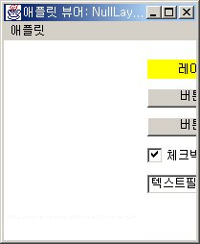
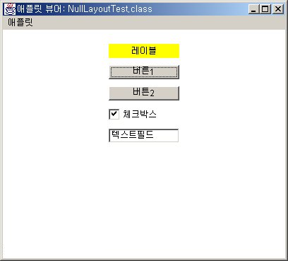
Role of Layout manager
No Layout Manager
With
Layout
Manager

Slide 29
How to assign Layout
Create Layout manager
  BorderLayout bm= new BorderLayout();
Set layout manager for component
  setLayout(bm);
Add Compoment
  add(myButton);
    Check API Documentations, for method varies for each layouts

Slide 30
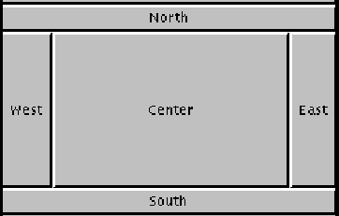
BorderLayout

Slide 31
BorderLayout
When adding component, You can select position with arguments
public LayoutFrame(){
  setLayout(new BorderLayout());
  add(new Button("North"), BorderLayout.NORTH);
  add(new Button("South"), BorderLayout.SOUTH);
  add(new Button("East"), BorderLayout.EAST);
  add(new Button("West"), BorderLayout.WEST);
  add(new Button("Center"), BorderLayout.CENTER);
}

Slide 32
Color & Font
Color
  Use R,G,B and alpha value to give color to component
  Constructors
    Color(float r, float g, float b, float a)
    Color(int r, int g, int b, int a)
Font
  Shape and size of texts printed out on screen
    BOLD, ITALIC, PLAIN
  Major methods
    getFont(), setFont(Font font)…
    Check API Documentation

Slide 33
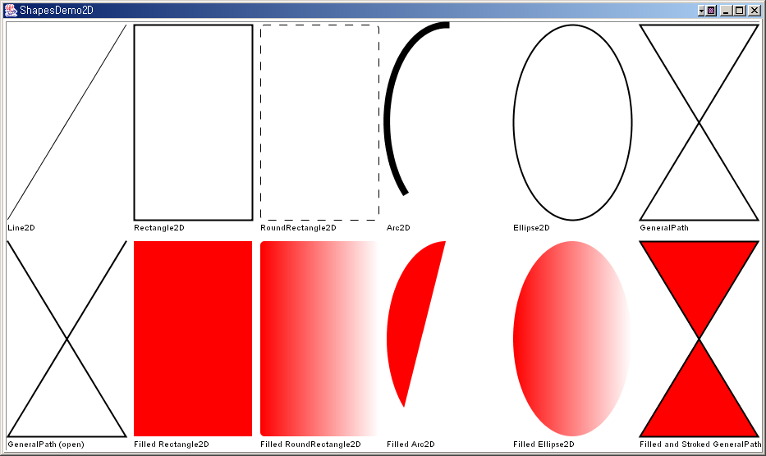
Drawing figure
Drawing inside : fillArc, fillRect…
Drawing outside : drawArc, drawRect…
Type of Figures
Line : 두께 1인 직선
Rect : 직사각형
3Drect : 3차원으로 입체감 있는 사각형
RoundRect : 모서리 둥근 사각형
Oval : 타원
Arc : 원호, 원의 일부 자른 모양
Polygon : 다각형. 시작점과 끝점 이어 만듬

Slide 34
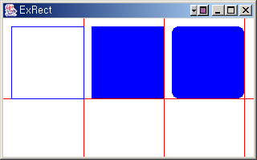
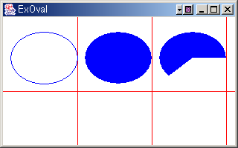
Drawing figure
Draw line
  drawLine(int x1, int y1, int x2, int y2)
Draw rectangular
  drawRect(int x, int y, int width, int height)
  draw3DRect(), drawRoundRect(), fillRect()…
Draw oval & arc
  Designate rectangular that oval will be drawn inside
    Oval is drawn inscribed in the rectangular
  Drawing starts at three o’clock and go counterclockwise with angle

Slide 35
Drawing String
Draws with method like drawString()
  Give font characteristics by FontMetrics
  Fonts have variable width
    Characters have its own width

Slide 36
Q&A
Q&A

Slide 37
Toolkit class
Parent class of object in AWT GUI toolkit
  Create components of AWT
  Connect with native component of system
Abstract Class
  Get class from Toolkit.getDefaultToolkit or getToolkit method of Component
getImage() returns image object immediately
java.awt.Toolkit 주요 메소드
Dimension | getScreenSize() | 스크린의 전체 크기를 얻는다
int | getScreenResolution() | 스크린의 해상도를 얻는다 (DPI: dots per inch)
Image | getImage(String filename) | 주워진 파일의 이미지를 가져온다
Image | getImage(URL url) | 주어진 URL의 이미지를 가져온다

Slide 38
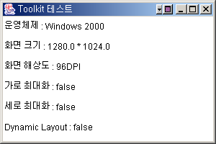
Toolkit example
Toolkit example for getting information
public void test() {
Toolkit toolkit = getToolkit();
Dimension dim = toolkit.getScreenSize();
toolkit.setDynamicLayout(true);
add(new Label("운영체제 : "+System.getProperty("os.name")));
add(new Label("화면 크기 : "+dim.getWidth()+" * "+dim.getHeight()));
add(new Label("화면 해상도 : "+oolkit.getScreenResolution()+"DPI"));
add(new Label("가로 최대화 : "+toolkit.isFrameStateSupported(Frame.MAXIMIZED_HORIZ)));
add(new Label("세로 최대화 : "+toolkit.isFrameStateSupported(Frame.MAXIMIZED_VERT)));
add(new Label("Dynamic Layout : "+toolkit.isDynamicLayoutActive()));
}

Slide 39
Drawing Image
drawImage(Image img, int x, int y, Color bgcolor, ImageObserver obs)
  Draw image at (x,y) position, with colors filled with bgcolor
ImageObserver
  For bigger image resources, ImageObserver object first loads image data and draw image with imageUpdate() method
Image zoom in/out
  Easily done by argument of drawImage() method

Slide 40
Managing image resources
Flatform other than java
  Stop other operation while loading image
  When created image object, load all data at once
Java flatform
  이미지 객체 생성 메소드 호출시 즉각 반환, 배후의 스레드가 로딩작업 처리.
ex:) Printing operation when image data is not fully ready
  자바이외의 플랫폼에서는 데이터가 완전히 로딩 될 때까지 기다린 후 출력 작업 시행
  자바 플랫폼에서는 현재 도달한 이미지를 가지고 출력 작업 처리

Slide 41
Printing image on screen
1. Get URL, file name of image file
2. Get Toolkit object
3. Call the image
4. Prepare Image
5. Print out Image
사용법
URL url = getClass().getResource(file_name);
Toolkit toolkit = Toolkit.getDefaultToolkit();
Image img = toolkit.getImage(url);
생성자 내용
URL url = new URL("http://java.sun.com/docs/books/tutorial/images/wood8.GIF");
imgExample = getToolkit().getImage(url);
Paint 메소드
public void paint(Graphics g){
if (
getToolkit().prepareImage(imgExample, -1, -1, this) == false
) {
g.drawString("Wait for Loading", 100, 100);
} else {
g.drawImage(imgExample, 10, 10, this);
}
}

Slide 42
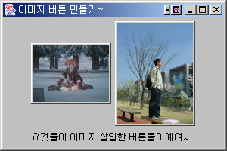
Image Button
Add image into buttons
ImageButton.java
public void paint(Graphics g){
if (xImage == null) super.paint(g);
else {
/* 이미지를 버튼의 중앙에 그린다. */
g.drawImage(
xImage
, (getWidth() - xImage.getWidth(this)) /2
, (getHeight() - xImage.getHeight(this)) /2
, this
);
}

Slide 43
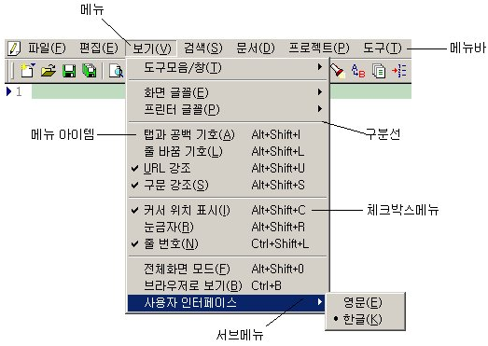
Menu Configuration

Slide 44
메뉴 만드는 법
메뉴가 붙을 메뉴바 생성
  MenuBar myMenuBar= new MenuBar();
메뉴 생성
  Menu myMenu= new Menu("내 메뉴");
메뉴 아이템을 만들어 메뉴에 추가
  MenuItem myMenuItem= new MenuItem("내 아이템");
  myMenu.add(myMenuItem);
메뉴바에 메뉴 추가
  myMenuBar.add(myMenu);
프레임에 메뉴바를 설치
  Frame myFrame= new Frame();
  myFrame.setMenuBar(myMenuBar);

Slide 45
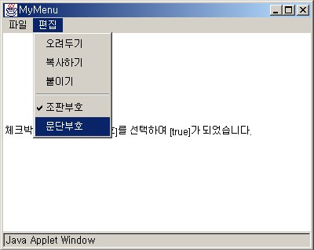
체크박스 메뉴
...
Menu myMenu= new Menu("내 메뉴");
CheckboxMenuItem myCheckboxMenuItem= new CheckboxMenuItem("내 체크박스메뉴");
myMenu.add(myCheckboxMenuItem);
...
MenuItem 대신
CheckboxMenuItem 사용

Slide 46
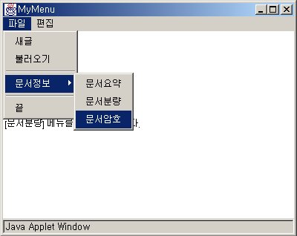
서브 메뉴
...
Menu myMenu= new Menu("내 메뉴");
Menu mySubMenu= new Menu("내 서브메뉴");
MenuItem mySubMenuItem= new MenuItem("내 서브메뉴 아이템");
mySubMenu.add(mySubMenuItem);
myMenu.add(mySubMenu);
...
MenuItem 대신
Menu 사용

